Slide 1
AI system personalizes software interfaces in real time using user behavior and feedback
24-25J-296

Slide 2
Introduction to Overall Research Project
Our project creates an AI for real-time interface personalization.
The Chrome Extension uses advanced AI for better interfaces.
It solves issues like limited data and poor adaptation.
The system improves personalization and efficiency.

Slide 3
Overall Research Project
Problem Statement
Limited history makes personalization harder for new users.
This leads to less relevant interface recommendations.
Smart techniques are needed to work with minimal data.
Customization should adapt to user actions and context.
Lack of these features reduces responsiveness and tailoring.
Better integration is needed for effective personalization.

Slide 4
Overall Research Project
Research Questions
What are the best practices for integrating user feedback into the AI system for continuous improvement?
How can AI-driven personalization improve overall user satisfaction and engagement?
How can user feedback be quantitatively and qualitatively measured to assess the system's performance?
What types of feedback mechanisms can be integrated to facilitate continuous learning and improvement of the AI system?

Slide 5
Overall Research Project
Research Questions
How can reinforcement learning be used to enhance the personalization process based on user feedback?
How can AI-based mechanisms be used to dynamically adjust UI variants in response to evolving user preferences?

Slide 6
Research Project Objectives
Main Objective
The project’s goal is to create an AI system that personalizes software interfaces in real-time.
It adjusts based on user behavior, preferences, and feedback to boost satisfaction and engagement by tailoring the software environment to individual needs.

Slide 7
Research Project Sub - Objectives
Adjusts UI/UX based on user behavior and preferences.
Tailors experiences to boost satisfaction and interaction.
Adapts software environment to individual needs.
Utilizes probabilistic models and reinforcement learning for adaptability.
Improves browsing for users with visual disabilities.

Slide 8
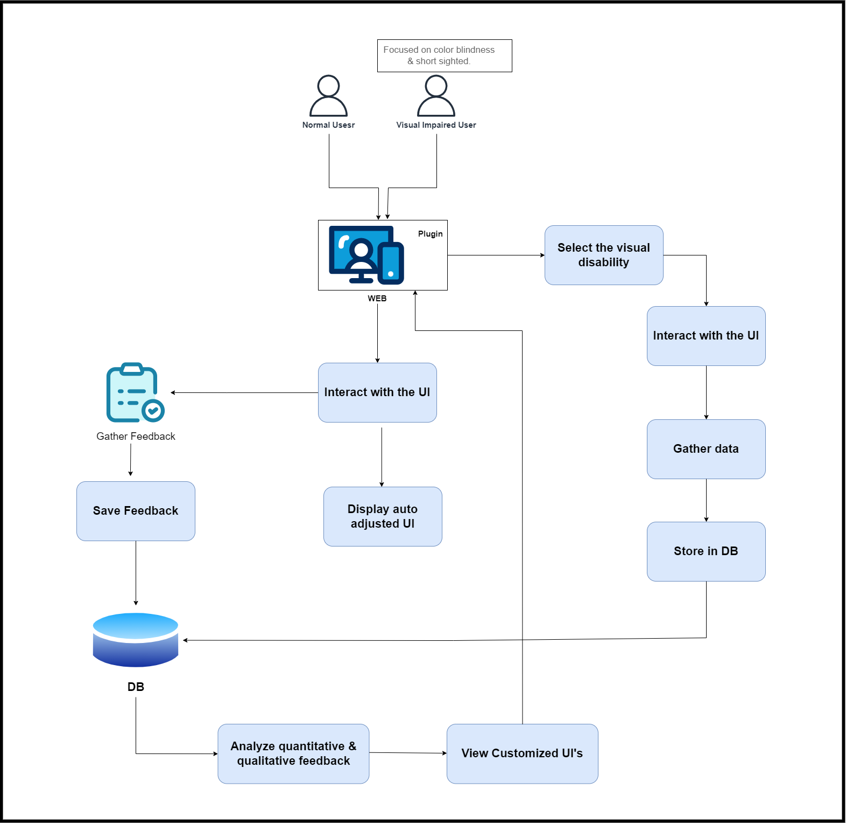
Overall System Diagram

Slide 9
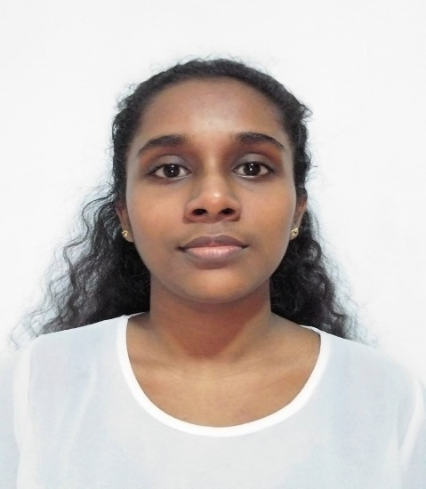
IT21324406 | Silva H.S.N
Software Engineering
IT21324406 | Silva H.S.N | 24-25J-296

Slide 10
Software User Interface Personalization through User Feedback
IT21324406 | Silva H.S.N | 24-25J-296

Slide 11
Challenges in Real-Time Personalization
Current Issue:
Traditional Software Interfaces are static and fail.
Users have varied preferences.
Real-time UI personalization.
Impact:
Reduced User Satisfaction.
IT21324406 | Silva H.S.N | 24-25J-296

Slide 12
System Solution
UI personalization through User Feedback:
Font Size and Color.
Font Alignment and Color Scheme.
Dynamic Adjustments:
Applies preferences by sending the user feedback.
Updates interface instantly.
IT21324406| Silva H.S.N. | 24-25J-296

Slide 13
Tools & Methods
Machine Learning Model
Predicts optimal UI adjustments.
Based on user feedback.
Feedback Collection
Feedback form collects user preferences.
IT21324406| Silva H.S.N. | 24-25J-296

Slide 14
Future Developments
Persist Changes for Revisited Websites:
Save User Feedback.
Reapply the saved settings.
Enhance UI Personalization:
Expand the feedback category.
Improve model accuracy
Testing
Test across various platforms.
IT21324406 | Silva H.S.N. | 24-25J-296

Slide 15
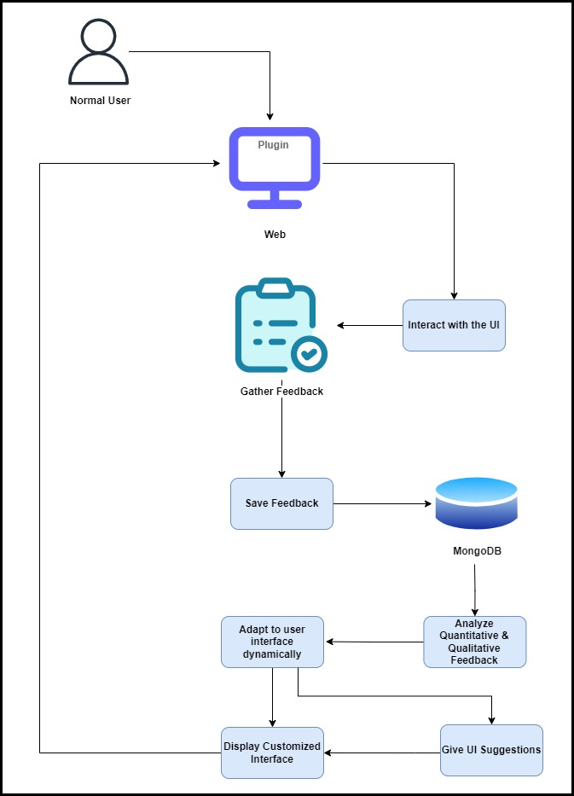
System Diagram
IT21324406| Silva H.S.N | 24-25J-296

Slide 16
Methodology
Technologies:
Collect User Feedback: In-App Surveys and Pop-Up Forms
Model Training: Random Forest Classifiers
Programming Languages and Tools: React.js, Python, Flask API
Database: MongoDB
Development Environment: Visual Studio Code
Version Control: Git and GitHub
IT21324406 | Silva H.S.N | 24-25J-296

Slide 17
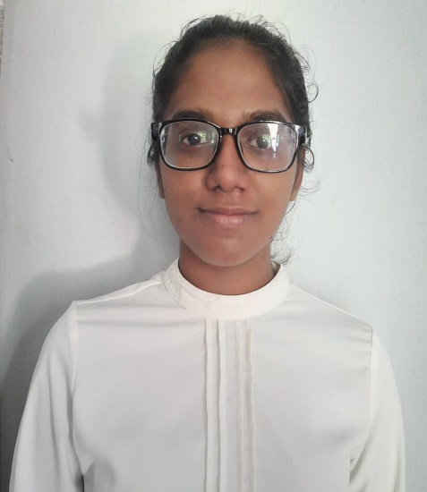
IT21215360 | Rosa M.D
Software Engineering
IT21215360 | Rosa M.D | 24-25J-296

Slide 18
Software User Interface Personalization through User Behavior
IT21215360 | Rosa M.D | 24-25J-296

Slide 19
Challenges in Real-Time Personalization
Current Issue:
Systems struggle with personalization using limited initial user data.
Real-time adaptability is difficult.
Impact:
Lower user satisfaction and engagement.
IT21215360 | Rosa M.D | 24-25J-296

Slide 20
System Solution
Tracks User Behavior:
Zoom level.
Font size.
Dynamic Adjustments:
Applies preferences live.
Updates interface instantly.
IT21215360 | Rosa M.D | 24-25J-296

Slide 21
Tools & Methods
Neural Networks:
Predict UI changes.
Based on user behavior.
Probabilistic Models:
Handle limited data.
Make accurate predictions.
Q-Learning:
Learns from interactions.
Improves over time.
IT21215360 | Rosa M.D | 24-25J-296

Slide 22
Future Developments
UI Enhancements:
Add font color and theme customization.
Refine interface for ease of use.
User-Specific Preferences:
Identify users individually.
Apply personalized settings for each user.
Comprehensive Testing:
Test across platforms and devices.
Ensure accessibility and reliability.
IT21215360 | Rosa M.D | 24-25J-296

Slide 23
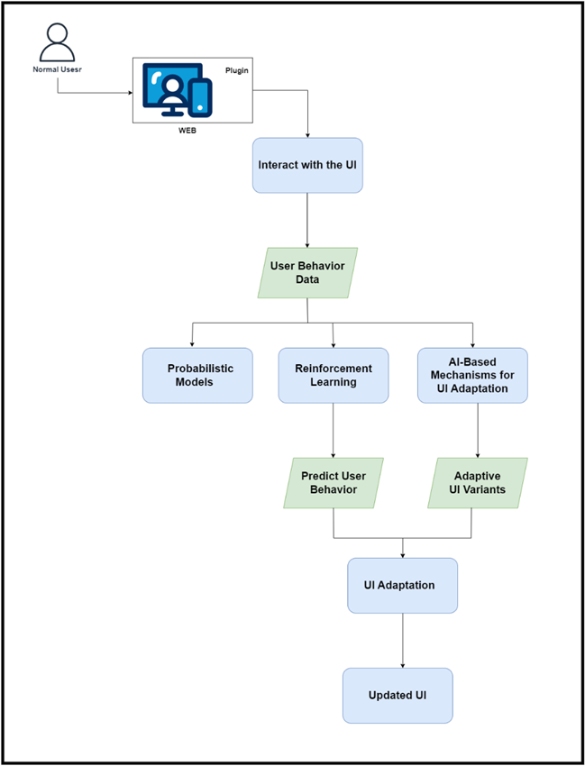
System Diagram
IT21215360 | Rosa M.D | 24-25J-296

Slide 24
Methodology
Technologies:
•Probabilistic Models: Bayesian networks, Hidden Markov Models
•Reinforcement Learning: Q-learning algorithms
•AI Mechanisms for UI Adaptation: Neural networks
•Programming Languages and Tools: Python, TensorFlow, PyTorch
•Development Environment: Visual Studio Code
•Version Control: Git and GitHub
IT21215360 | Rosa M.D | 24-25J-296

Slide 25

IT17117210 | SaNDUN Geemal H.L
Information Technology
IT17117210 | Sandun Geemal H.L | 24-25J-296

Slide 26
Improving Browsing Experience for Users with Visual Disabilities
IT17117210 | Sandun Geemal H.L | 24-25J-296

Slide 27
Specific and Sub Objectives
Develop Interactive Tests for Visual Impairments
Apply machine learning models trained on the dataset to analyze user responses in real-time.
Dynamic Adjustment of Browser Settings
Dynamically adjust text sizes, contrast settings, and color schemes based on user test results
Develop Customizable User Interface
Allows users to customize their browser settings based on their accessibility preferences.
Implement Real-Time Adaptation
ensuring immediate application of changes without requiring page reloads
IT17117210 | Sandun Geemal H.L | 24-25J-296

Slide 28
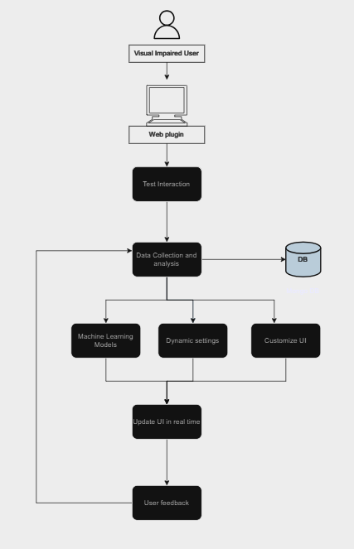
System Diagram
IT17117210 | Sandun Geemal H.L | 24-25J-296

Slide 29
Methodology
Technologies:
Collect User data: In-App Surveys and Pop-Up Forms
Model Training: support vector machine , Random Forest Classifiers, Decision Tree Classifier
Programming Languages and Tools: React.js, Python
Database: MongoDB
Development Environment: Visual Studio Code
Version Control: Git and GitHub
IT21324406 | Silva H.S.N | 24-25J-296

Slide 30
System Solution
Predicts color blindness according to user:
Recognize which color blind group user belong to.
IT21215360 | Rosa M.D | 24-25J-296

Slide 31
Tools & Methods
Machine Learning Model
Predicts color blindness.
Based on user interaction with quiz.
IT21215360 | Rosa M.D | 24-25J-296

Slide 32
Future Developments
System support for short sightedness users:
Add pop up questions for users.
Refine interface for ease of use.
User-Specific Preferences:
Apply personalized settings for each user.
Comprehensive Testing:
Test across platforms and devices.
Ensure accessibility and reliability.
IT21215360 | Rosa M.D | 24-25J-296

Slide 33
Future Developments
Persist Changes for Revisited Websites:
Save User preferences.
Reapply the saved settings.
Enhance UI Personalization:
Add featre to short sightness sers.
Improve model accuracy
Testing
Test across various platforms.
IT21324406 | Silva H.S.N. | 24-25J-296

Slide 34
References
[1] M. Sili, M. Garschall, M. Morandell, S. Hanke, and C. Mayer, "Personalization in the User Interaction Design," in HCI 2016, Part I, LNCS 9731, Springer, 2016, pp. 198–207. DOI: 10.1007/978-3-319-39510-4_19
[2] M. C. Schraefel, "Building Dynamic Systems for Universal Usability: The Value of User Experience Design," in Universal Access in Human-Computer Interaction. Design and Development Methods for Universal Access, Springer, 2015, pp. 47–56. DOI: 10.1007/978-3-319-18374-9_5
[3] T. Jokela and K. H. Tammi, "User Experiences in Context-Aware Mobile Applications," in Human-Computer Interaction – INTERACT 2015, Springer, 2015, pp. 36–44. DOI: 10.1007/978-3-319-18374-9_5
[4] M. Monteiro-Guerra, et al., "Personalization in Real-Time Physical Activity Coaching," IEEE Journal of Biomedical and Health Informatics, vol. 23, no. 1, pp. 1-12, 2019
[5] F. Villaça, et al., "Analyzing the Usability and User Experience of Telemonitoring Systems for Chronic Patients," Journal of Biomedical and Health Informatics, vol. 21, no. 1, pp. 1-12, 2017
[6] T. Nieminen, et al., "Designing a Context-Aware Mobile Application for Real-Time Physical Activity Coaching," IEEE Journal of Biomedical and Health Informatics, vol. 20, no. 1, pp. 1-12, 2016

